Slide 1
INCIDENT MANAGEMENT-I
Information Security Incident Management
Have a look at ISO27002: 2013 (Page 67+) for best practices guidance

Slide 2
INCIDENT MANAGEMENT-I
Objective:
“To ensure a consistent and effective approach to the management of information security incidents, including communication on security events and weaknesses.”
ISO27001:2013 (16.1)

Slide 3
INCIDENT MANAGEMENT-I
Top 10 Considerations For Incident Response
https://www.owasp.org/images/9/92/Top10ConsiderationsForIncidentResponse.pdf

Slide 4
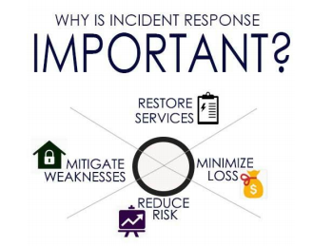
INCIDENT MANAGEMENT-I
https://www.owasp.org/images/9/92/Top10ConsiderationsForIncidentResponse.pdf

Slide 5
INCIDENT MANAGEMENT-I
Audit & Due Diligence
Performing an audit will let you know how well prepared the organization is for Incident Response​in terms of:
People
Process
Equipment

Slide 6
INCIDENT MANAGEMENT-I
2. Create Response Team
An Incident Response team should consist of people with sufficient technical skills. It is important that the team members consist of SME's (Subject Matter Experts) or Knowledge Engineers from different domains across the organization.

Slide 7
INCIDENT MANAGEMENT-I
2. Create Response Team
Team lead
Triage officer
Incident handler

Slide 8
INCIDENT MANAGEMENT-I
3. Create Documented IR Plan
An organization should have a well-documented IR plan that would guide the IR Team during an incident.
A comprehensive plan at minimum , should cover Roles & Responsibilities, Investigation, Triage and Mitigation, Recovery, and Documentation process.

Slide 9
INCIDENT MANAGEMENT-I
4. Identify Indicators & Triggers
What would be categorized as an incident at your organization?
How important or weighty are the factors that would trigger an incident?
Clearly define what can trigger an incident

Slide 10
INCIDENT MANAGEMENT-I
5. Investigate the Problem
Establishing , clearly what has occurred
Identify what systems, people or processes have been compromised or affected based on incident
Determine what happened & what was compromised

Slide 11
INCIDENT MANAGEMENT-I
5. Investigate the Problem
Determine the point of origin of the incident where possible. This infers that you establish the source of the threat or attack vector
Specify your investigation objectives, triage and resolution methodology
END

